Slide 1
EBAY WEBSITE
Under Guidance of Mrs. Vaishali Sonanis Mam.
By : Ravi Yasaswini

Slide 2
INTRODUCTION
eBay is a global e-commerce marketplace that connects millions of buyers and sellers worldwide.
It allows individuals and businesses to list, buy, and sell a wide range of products, from new items to rare collectibles.
With features like auctions, “Buy It Now,” and seller stores, eBay provides a trusted platform for online shopping and trading.

Slide 3
Responsibilities
Designed test cases for different modules of the eBay website (Sign in, Search, Cart, Categories, Account settings, Watchlist, etc.).
Identified and tracked defects by preparing detailed defect report.
Executed all the testcases.
Create Defect Report.

Slide 4
OVERVIEW
eBay is a global e-commerce website that enables users to buy and sell products online.
It supports both auction-style listings and fixed-price sales through its “Buy It Now” option.
Sellers can create their own stores on eBay to showcase products and reach worldwide customers.
It helps individuals and businesses connect with millions of buyers and grow their online presence.
eBay also provides features like secure payment through PayPal/eBay Payments, product tracking, and customer feedback ratings.

Slide 5
MODULES
MODULE 1: SIGN-IN PAGE
Checked all the functionalities on the Sign In page including email address, password, and login validation.
MODULE 2: SEARCH MODULE
Verified the product search functionality including search bar, auto-suggestions, and search results display.
MODULE 3: CART PAGE
Checking add to cart, remove from cart, update quantity, and view cart summary functionalities whether it updating or not correctly.

Slide 6
MODULE 4: CATEGORY MODULE
Tested browsing through whether it’s selecting correct categories, and product listings within each category.
MODULE 5: ACCOUNT SETTINGS
Verify profile settings, personal information update, address details, and payment methods.
MODULE 6: LANGUAGE
Checked the ability to change site language and verified translation accuracy across pages.
MODULE 7: WATCHLIST
Verified adding items to Watchlist, removing items, and tracking saved products.

Slide 7
DEFECTS
While running a testcase at certain point some fields are not working as it is expected which is nothing but a defect, so I have created a Defect report on those defects.

Slide 8
Defect identifier :- B_001
Ø Defect summary :- Captcha verification appears frequently during sign-in process and sometimes does not load properly
Ø Test Id :- TC_001
Ø Test case name :- TC _ captcha_Verification
Ø Module name :- Sign-in page
Ø Reproducible :-
Ø Severity :- medium
Ø Priority :- medium
Ø Raised by :- Yasaswini
Ø Assigned to :- Developer
Ø Date of assignment :-18-08-2025
Ø Status :- PENDING
Ø Snap shots :-
Ø Fixed by :- developer
Ø Date of fixing :-

Slide 9
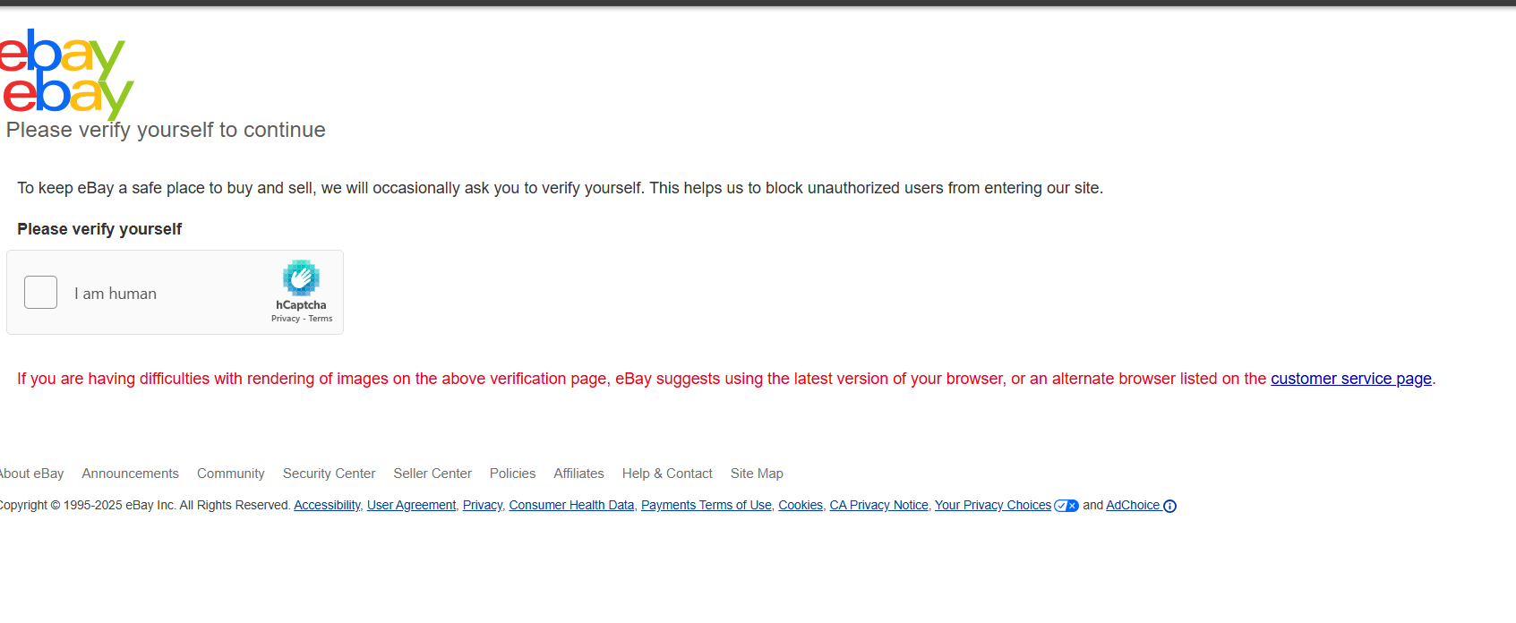

Slide 10
Defect identifier :- B_002
Ø Defect summary :- Street Address field is accepting invalid numeric values (e.g., “56789”) and City field accepts incorrect values without validation. No error message is displayed, allowing the user to save invalid data.
Ø Test Id :- TC_003
Ø Test case name :- TC_invalid_address_validation
Ø Module name :-Account settings
Ø Reproducible :-
Ø Severity :- medium
Ø Priority :- High
Ø Raised by :- Tester
Ø Assigned to :- Developer
Ø Date of assignment :-18-08-2025
Ø Status :- PENDING
Ø Snap shots :-
Ø Fixed by :- developer
Ø Date of fixing :-

Slide 11
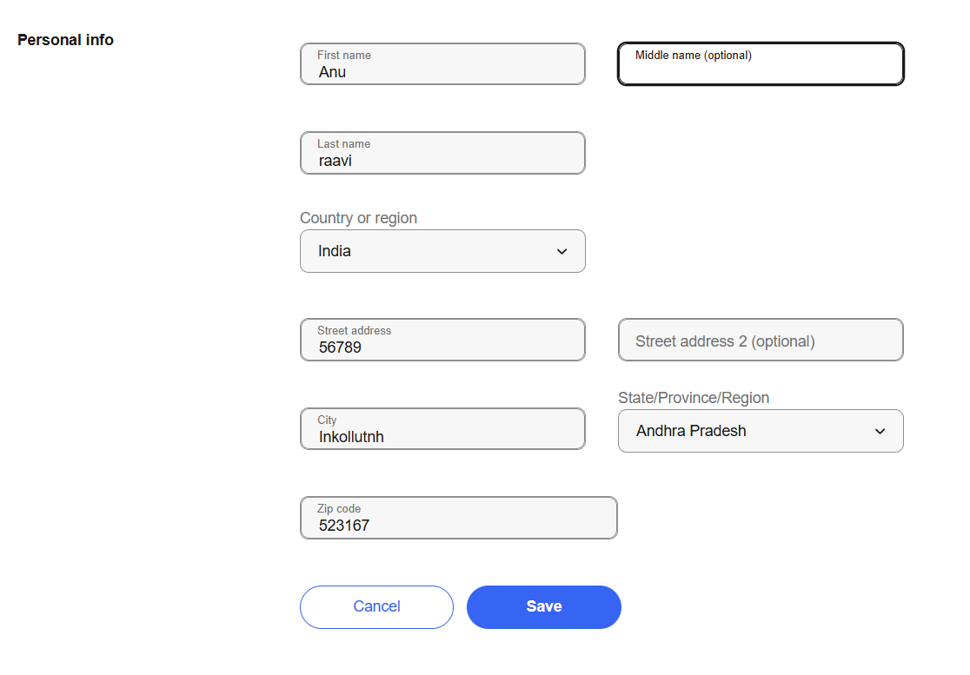

Slide 12
CHALLENGES
Test Execution sometimes passed and sometimes failed due to synchronization issues for the eBay web application.
Authentication Handling: While testing the Sign In page, eBay sometimes triggered additional authentication steps.
Handling waits: At first, I used Thread. sleep() ,but it made scripts slow. Then I implement implicit wait for dynamic elements, then its working fine.

Slide 13
EXPERIENCE
This project helped me to improve my test case writing skills, as I had to think about every possible scenario .
Identified multiple defects during manual and automation testing, which improved my bug reporting skills.
Manual testing require strong observation , so I practised applying all possible input combinations.
Automation testing with selenium and TestNG taught me how to design test scripts, handle waits effectively.

Slide 14
Thank You!!!
Vaishali Mam For Guiding Us through out the Project.

